Slide 1
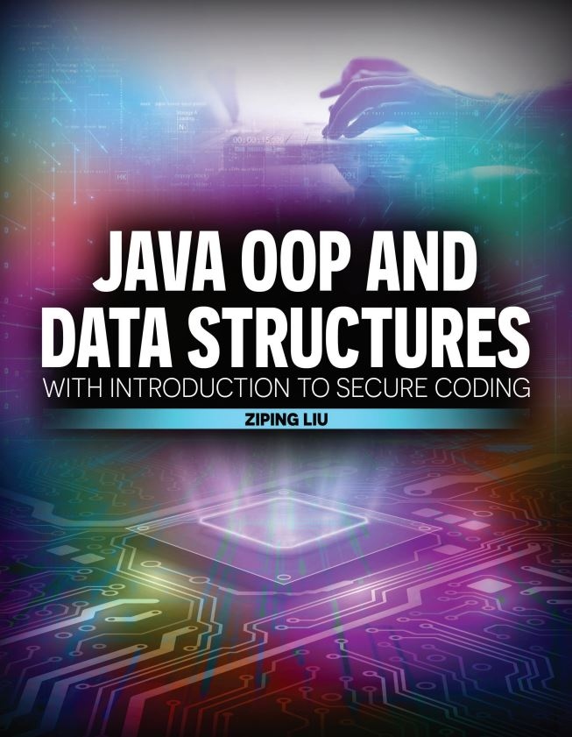

Slide 2

Java OOP and Data Structures with Introduction to Secure Coding Dr. Ziping Liu
Chapter 7 Exceptions

Slide 3
https://he.kendallhunt.com/product/java-oop-and-data-structures-introduction-secure-coding
Chapter 7 Exceptions

Slide 4

Chapter Outlines
Defining and recognizing exceptions
Handling exceptions with a try-catch(-finally) block
Understanding the Java exception class hierarchy
Differentiating between checked and unchecked exceptions
Handling checked exceptions within a method
Declaring checked exceptions for other methods to handle
Using chained exceptions (available on the supplemental website)
Creating customized exceptions (available on the supplemental website)
More on Java Secure Coding Guidelines (available on the supplemental website)

Slide 5
7.1 What is an Exception?
a run-time issue that disrupts the normal flow of program execution
Performing condition checks in a program can prevent exceptions from occurring. However, more complex programs may have many potential error conditions, and individually checking for each condition can be impractical. The best way to handle abnormal conditions in these cases is to apply the principles of exception handling.

Slide 6
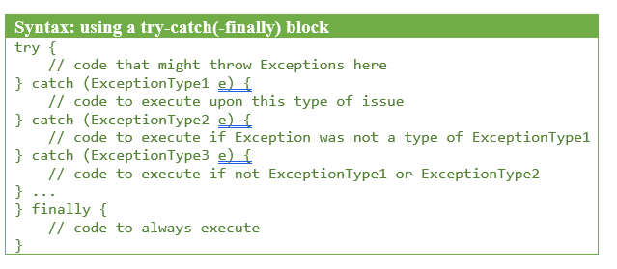
7.2 Exception Handling
surround the code that might cause issues with a try-catch block

Slide 7
7.3 Java Exception Class Hierarchy
All exceptions are also objects
the superclass of all exceptions is Throwable
the parameters to the catch blocks of a try-catch(-finally) block are all subtypes of Throwable
The direct subclasses of Throwable are Exception (with a capital E) and Error
We can use try-catch(-finally) blocks to handle Exception-type objects and recover from the issue. Errors, on the other hand, are created when something external to the Java application goes wrong. You should NOT catch Errors within try-catch(-finally) blocks and attempt to handle them, because programs usually cannot recover after an Error occurs

Slide 8
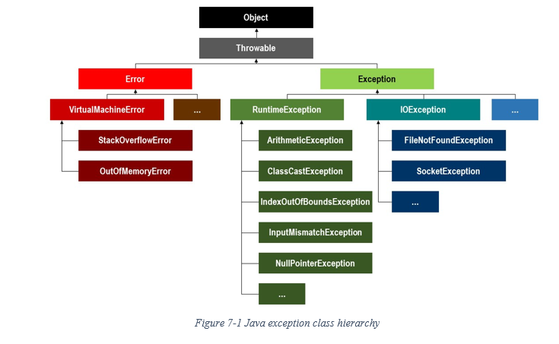
7.3 Java Exception Class Hierarchy

Slide 9
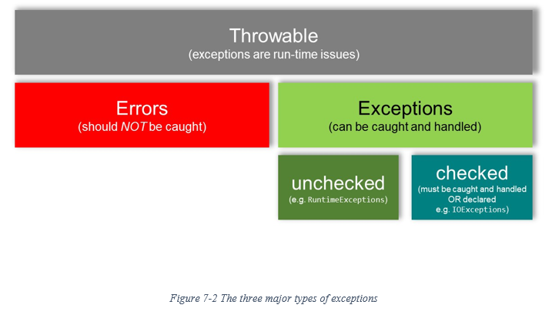
7.4 Checked vs. Unchecked Exceptions

Slide 10
7.4 Checked vs. Unchecked Exceptions
Throws an exception
A method executes code that either explicitly uses the throw keyword or calls another method that might throw an exception
If the exception is a checked exception (e.g., IOException), the method must either handle it with a try-catch block or declare that it throws the exception using the throws keyword in its method signature. If a method does neither for a checked exception, the code will not compile.
If the exception is an unchecked exception (a RuntimeException), the method is not required to handle it or declare it.
If an exception (checked or unchecked) is thrown and not caught anywhere in the current method's execution stack, it propagates up to the calling method.
If the exception reaches the main method and is still uncaught, the program terminates, and an error message (a stack trace) is printed to the console.

Slide 11
7.4 Checked vs. Unchecked Exceptions
Unchecked Exceptions are not required to be handled
Checked Exceptions must be handled
Handling Checked Exceptions
If a program could throw a checked exception, the program must put the potentially problematic code within a try-catch(-finally) block and handle the checked exception
if the program does not catch and handle the checked exception, the programmer must declare the exception, usually in the method header

Slide 12
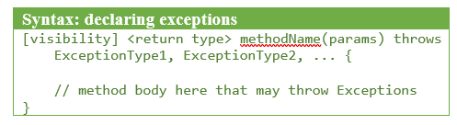
7.4 Checked vs. Unchecked Exceptions
Declaring Checked Exceptions

Slide 13
7.4 Checked vs. Unchecked Exceptions
The benefit of declaring checked exceptions in the method header and handling the exceptions in the main() method (or some other method that invokes methods with declared exceptions):
separate task code from error-handling code

Slide 14
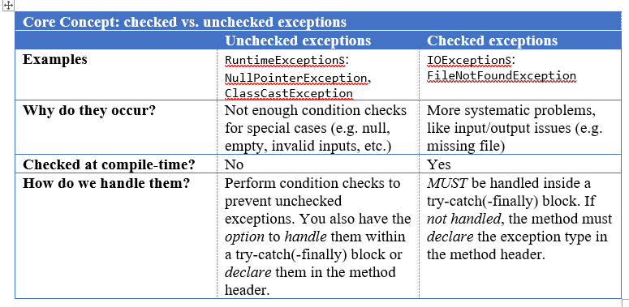
7.4 Checked vs. Unchecked Exceptions

Slide 15


Slide 16


Slide 17
Which National Park is it?
Answer: Badlands National Park

